Slide 1
MODULE : 24

Slide 2
Q. A Lead pencil consists of a cylinder of wood with a solid
cylinder of graphite filled in the interior. The diameter
of the pencil is 7 mm and the diameter of the graphite is 1 mm.
If the length of the pencil is 14cm, find the volume of
the wood and that of the graphite.
The diameter
of the pencil is 7 mm and the diameter of the graphite is 1 mm.
the length of the pencil is 14cm
Soln.
1
Diameter of the graphite cylinder
= 1mm
=
cm
10
1
1
1
1
∴ Radius
=
÷
2
=
×
=
cm
10
10
2
20
1cm = 10mm
The length of the graphite is same as the length of the pencil
7
1
Diameter of the pencil
= 7mm
∴ 1mm =
cm
=
cm
10
10
7
7
1
7
∴ Radius
=
÷
2
=
×
=
cm
10
10
2
20
Length of the pencil
= 14cm
Length of the graphite
= 14cm

Slide 3
Q. A Lead pencil consists of a cylinder of wood with a solid
cylinder of graphite filled in the interior. The diameter
of the pencil is 7 mm and the diameter of the graphite is 1 mm.
If the length of the pencil is 14cm, find the volume of
the wood and that of the graphite.
find the volume of
the wood
graphite
Volume of the
graphite cylinder
=
1
cm
Radius of graphite cylinder =
Radius of pencil =
Length of pencil & graphite = 14 cm
11
2
20
22
1
1
=
×
×
×
14
7
7
20
20
cm
10
20
5
11
So, the length of the graphite is the height of the cylinder
Graphite is cylindrical in shape
=
100
What is the formula for volume of the cylinder ?
πr²h
πr²h
Wood is the part of the pencil excluding the graphite
=
0.11 cm³
Volume of
the wood
Volume of the pencil
Volume of the graphite
=
-

Slide 4
MODULE : 25

Slide 5
Volume of the
pencil
=
πr²h
11
7
7
7
1
22
Radius of graphite
cylinder
Radius of pencil =
Length of pencil = 14cm
=
14
=
cm
×
×
×
7
20
20
20
10
7
cm
5
539
20
=
So, the length of the pencil is the height of the cylinder
100
Pencil is cylindrical in shape
Volume of the
graphite cylinder
= 5.39cm³
=
0.11 cm³
What is the formula for volume of the pencil ?
πr²h
=
5.39
- 0.11
= 5.28cm³
∴
Volume of the wood is 5.28cm³
Volume of
the wood
Volume of
the wood
Volume of the pencil
Volume of the graphite
Volume of the pencil
Volume of the graphite
-
=
-
=

Slide 6
MODULE : 26

Slide 7
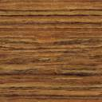
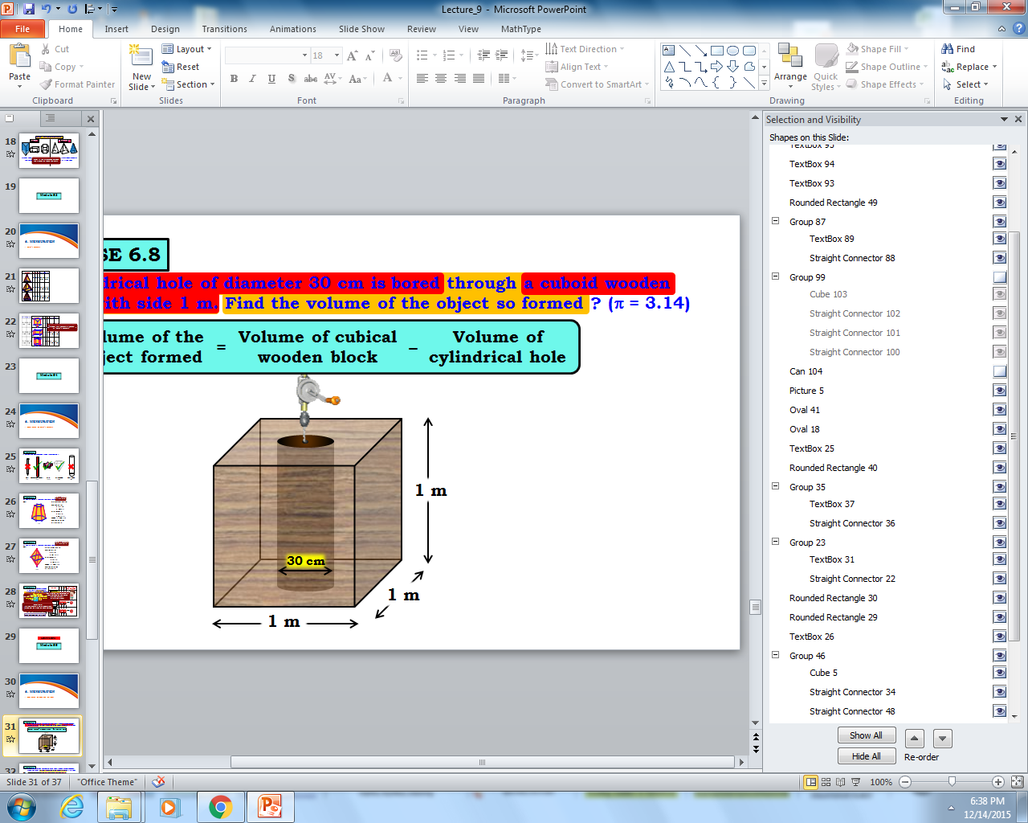
Q. A cylindrical hole of diameter 30 cm is bored through a cuboid wooden
block with side 1 m. Find the volume of the object so formed ? (π = 3.14)
Volume of the object formed
Volume of cubical wooden block
Volume of cylindrical hole
=
–
1 m
30 cm
1 m
1 m

Slide 8
Q. A cylindrical hole of diameter 30 cm is bored through a cuboid wooden
block with side 1 m. Find the volume of the object so formed ? (π = 3.14)
Sol.
Volume of the object formed
Volume of cubical wooden block
Volume of cylindrical hole
=
–
Side of cubical wooden block
=
1 m
1 m
=
100 cm
Volume of cubical wooden block
30 cm
=
l³
=
(100)³
1 m
Volume of cubical wooden block
1 m
=
1000000 cm³
What is formula for
finding volume cuboid ?
l³
A cylindrical hole is bored through the cubical wooden block.
∴
Height of cylindrical hole (h)
=
1 m
=
100 cm
Diameter of cylindrical hole
=
30 cm
30
∴
Its radius (r)
=
=
15 cm
2

Slide 9
Q. A cylindrical hole of diameter 30 cm is bored through a cuboid wooden
block with side 1 m. Find the volume of the object so formed ? (π = 3.14)
Sol.
Volume of the object formed
Volume of cubical wooden block
Volume of cylindrical hole
=
–
Volume of cylindrical hole
=
πr²h
1 m
=
3.14
×
×
15
×
100
15
Volume of cylindrical hole
=
70650 cm³
30 cm
What is formula for
finding volume of cylinder ?
1 m
Volume of the object formed
Volume of cubical wooden block
Volume of cylindrical hole
=
πr²h
–
1 m
=
1000000
–
70650
=
929350 cm³
Height of cylindrical hole (h)
=
100 cm
∴
Its radius (r)
=
15 cm
Volume of the object so formed is 929350 cm³.
Volume of cubical wooden block
=
1000000 cm³

Slide 10
MODULE : 27

Slide 11
Right Circular Cone
The Right Circular Cone has two faces.
One circular face
Let us see a geometrical figure of right circular cone
A cone has one circular face
How many circular faces
do we see here?
How many curved faces
do we see here?
How many faces do we see here?
Let the slant line be l
Let the radius be r
Let the height of the cone be h
Height is the perpendicular distance
One face
One face
Two faces
One curved face
l
h
1
2
r
1
1

Slide 12
Formulae
1. l²
= r² + h²
Let us see some formulae related to
Right Circular Cone
h
l
l, h and r belongs to
what type of triangle?
So, can we get any relation between l, h and r
Right angled triangle
Yes
2. Curved surface area =
π r l
π r l
By pythagoras theorem
3. Total surface area =
π r ( r + l )
r
4. Volume
1
What is area of
circular surface?
=
×
πr²h
π r²
3
Volume of a cone
is the capacity of
the cone
Total
surface
area
Curved
surface
area
Area of
circular
face
=
+
=
π r ( r + l )

Slide 13
MODULE : 28

Slide 14
Q. Find the total surface area of a cone, if its slant height
is 21m and diameter of its base is 24m.
Find the total surface area of a cone
if its slant height
is 21m
diameter of its base is 24m
Soln.
For the given cone,
l = 21m
What is the formula
for the total surface
area of the cone ?
πr(l + r)
24
πr(l + r)
r =
= 12m
2
Total surface area of the cone
=
22
=
×
12
×
(21
+
12)
7
4.714
22
=
×
12
×
33
7
=
1244.57m² (approx.)
∴
Total surface area of the cone is
1244.57m² (approx.)

Slide 15
A right angled triangle ABC with sides 5cm, 12 cm and
Q. A right angled triangle ABC with sides 5cm, 12 cm and
13 cm is revolved about the side 12 cm. Find the volume
of the solid so obtained.
13 cm is revolved about the side 12 cm
Find the volume
of the solid so obtained.
Soln.
On revolving the right angled ΔABC about the side AB
(12 cm), we get a cone as shown in the figure.
A
The solid object so formed is a cone
Volume of solid so obtained =
1
⁴
13cm
=
×
π
×
5 × 5
×
12
12cm
3
= 100π cm³
5cm
C¹
B
C
∴ Volume of solid so obtained = 100π cm³
1
1
What is the formula for volume of a cone ?
πr²h
πr²h
3
3

Slide 16
Thank You

